Slide 1
MongoDB

Slide 2
RDMS – Short Recap
Normalization
What is Good
What is Bad
Schema Design
Need for primary and foreign key

Slide 3
NoSQL - MongoDB
DE normalization – Embedding
Referencing
Schema-less Design (Dynamic Schema)

Slide 4
What can go wrong when there is no Schema
Data Types
Key & Value
Array
Embedded Objects
All ends up as BSON
Missing key
Inconsistent data Types
Validator can perform COMPLEX validations

Slide 5
Constructing Query
Projection (Select Clause)
Specify what key to return
Specify what key to exclude
$elementMatch
Query Criteria ( Where Clause)
Simple : $lt, $lte, $gt, $gte, $eq, and $ne
Array : $or, $and, $in and $nin
Type safe Query
$exists, $type
Querying Array
$all, $size, exact match, $elementMatch
Querying Array
$all, $size, exact match, $elementMatch

Slide 6
Simple CRUD
Create : Collection, Document
insert, insertOne, insertMany
Read : Collection, Document
find, findOne
Update : Collection, Document
update, updateOne [full doc replacement, update value]
$push
Delete : Collection, Document
remove, deleteOne, deleteMany, $unSet
Write Concern : Write concern describes the level of acknowledgment requested from MongoDB for write operations to a standalone mongod or to replica sets or to sharded clusters.

Slide 7
Aggregation
Transform and Combine results
Filtering
$match, all logical operators
Grouping
$avg, $sum, $min, $max, $first, $last
Projection
arithmetic operators ($add, $multiply, $divide and $subtract)
string operators
Logical expressions
Date expression
UnWind

Slide 8
Collections, Index, Query Explain
Capped Collection
Index
TTL Index
Unique Index
Index with Expressions
Explain Query
Understanding Explain Results

Slide 9
When to Embed &When to Reference ?
Embedding is better for... | References are better for...
Small subdocuments | Large subdocuments
Data that does not change regularly | Volatile data
Documents that grow by a small amount | Documents that grow a large amount
Data that you’ll often need to perform a second query to fetch | Data that you’ll often exclude from the results
Fast reads | Fast writes

Slide 10
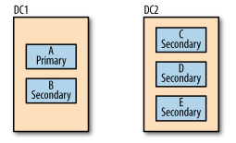
Replica Set
What is Replication ?
Primary
Secondary
Arbiter
How replication work ?
How election work ?
What is majority in replica set ?

Slide 11
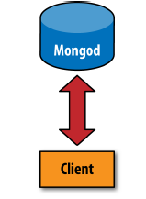
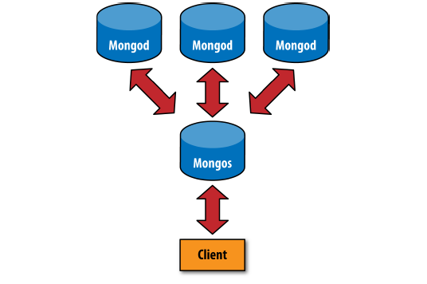
Data Partition or Shard

Slide 12
Data Partition or Shard
What is need for shards or partitioning ?
What is shard cluster ?
Components of Shard Cluster
Primary (mongod)
Secondary (mongod)
Config Serve (mongod)
Query Router (mongos)
Tagging
Range Definition

